Slide 1
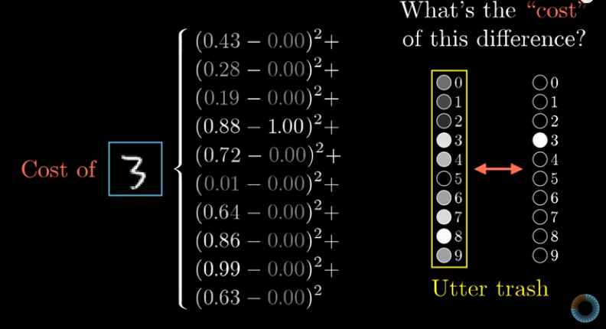
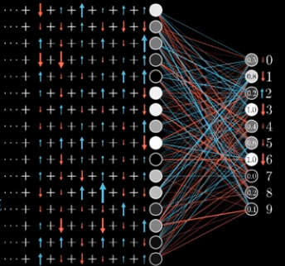
CNNs: Back Propagation
Feedforward: inputs are multiplied by weight matrices and biases at each edge between nodes resulting in a scalar value (usually [0,1]) corresponding to the likelihood of each output node being the correct output value
Back propagation: tells the network, based on how wrong it was, how to adjust weights and biases to be less wrong in the future
1: Take the squares of the differences of output values and correct value (cost/error)
2: “nudge” the weights and biases between output layer and the layer before it to minimize this cost value (the more incorrect a output node is the more it should be changed)
Recursively do this every set of two adjacent layers (moving backward from output layer) until all weights and biases have been adjusted
Repeat for all training examples (in this case repeat many times for different images with different numbers)
This figure shows how the weights & biases are changed at one layer over multiple trainings with different numbers, different number push the weights in different directions eventually, hopefully, landing on a number that works for all
3 Blue 1 brown youtube: https://www.youtube.com/watch?v=Ilg3gGewQ5U

Slide 2
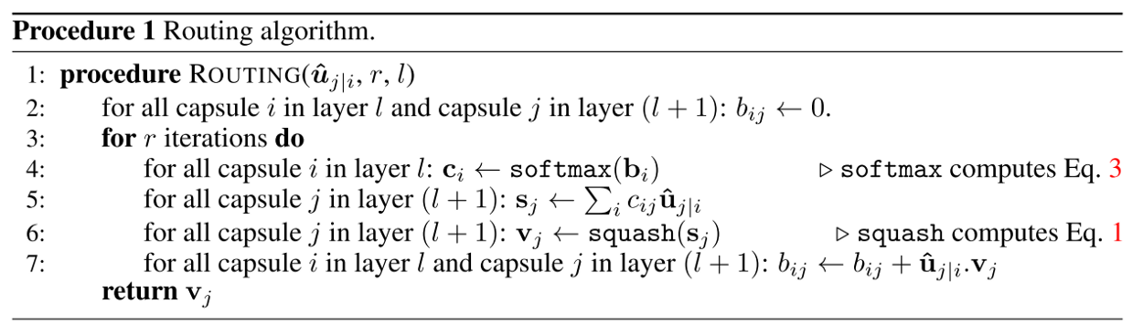
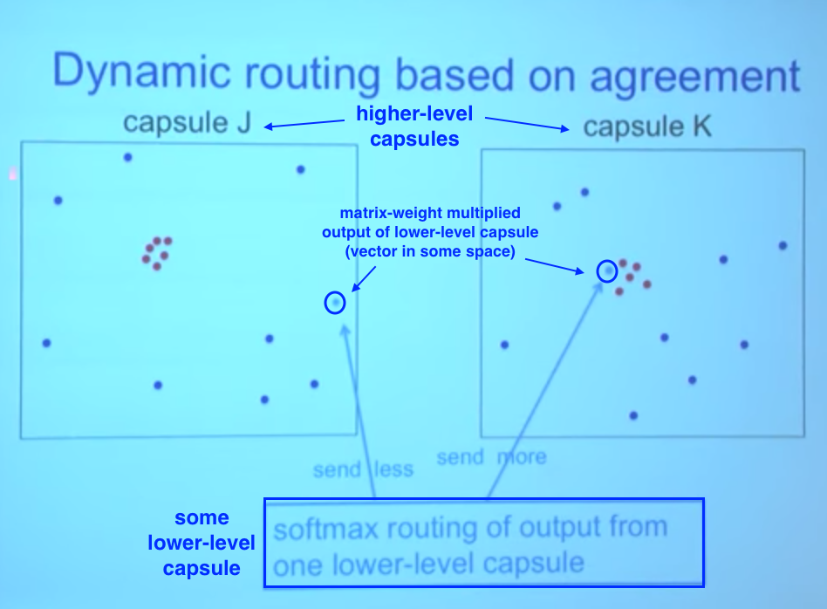
Dynamic Routing
Dynamic routing calculates a second set of weight values (Bij), used in conjunction with back-propagated weight values, that tell a capsule (neuron) in level L which capsule in L+1 would be most relevant to send its output to
Does this by “seeing into the future”:
Calculates what the output of each capsule in L+1 would be with initial weight value Bij
Adds to Bij the value of the dot product between the current output of the higher level capsule j and the input from the lower level i
This will raise the weight value if the two vectors are pointing in similar directions, thus sending a stronger output to this capsule
This is then repeated for each capsule in layer L
Would send output more strongly to capsule K
https://medium.com/ai%C2%B3-theory-practice-business/understanding-hintons-capsule-networks-part-iii-dynamic-routing-between-capsules-349f6d30418

Slide 3
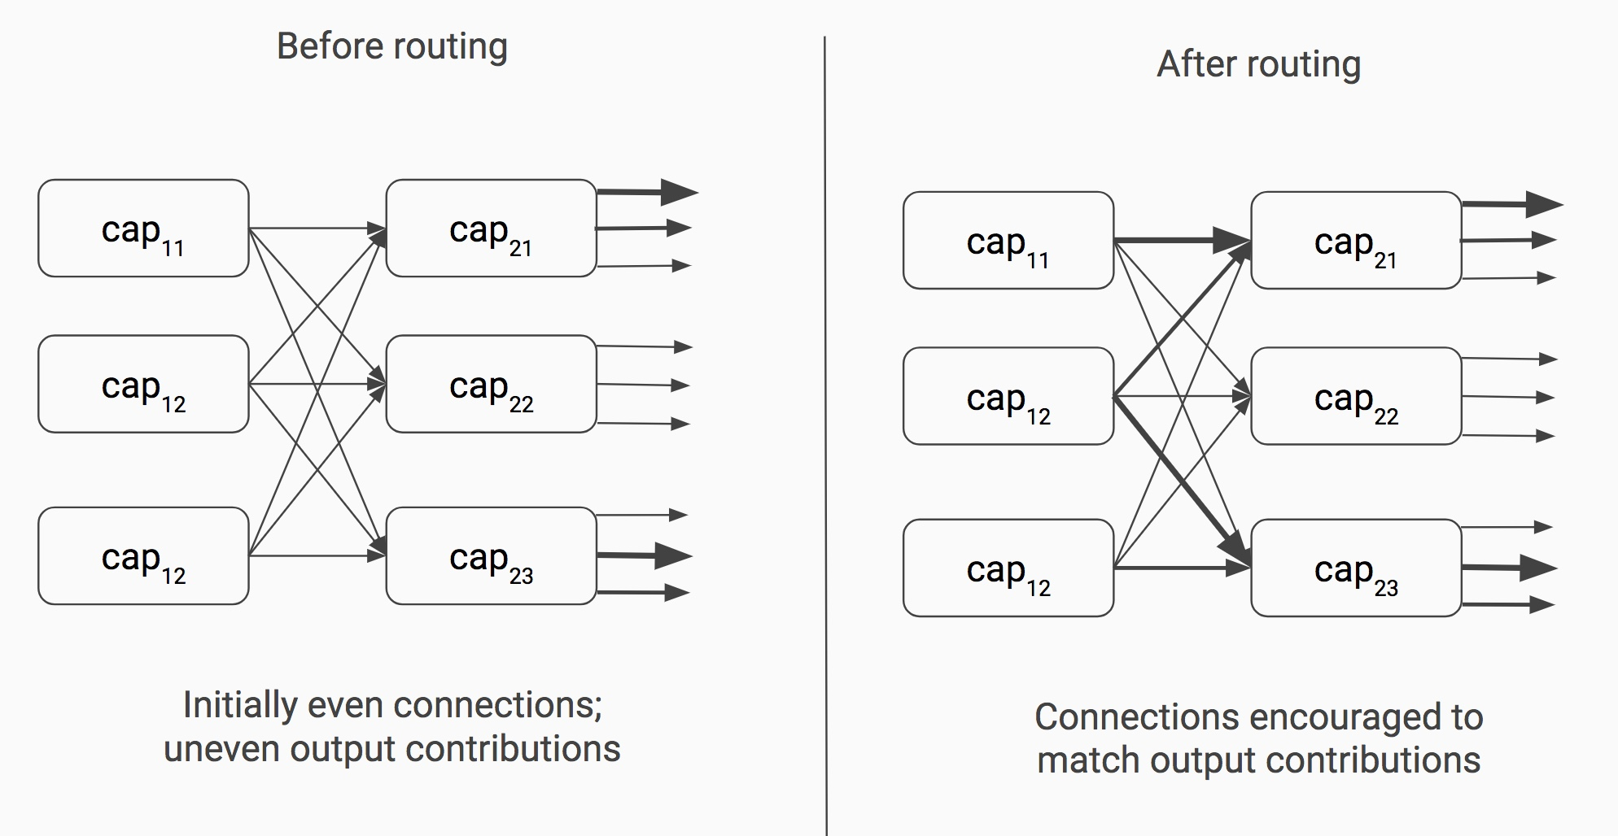
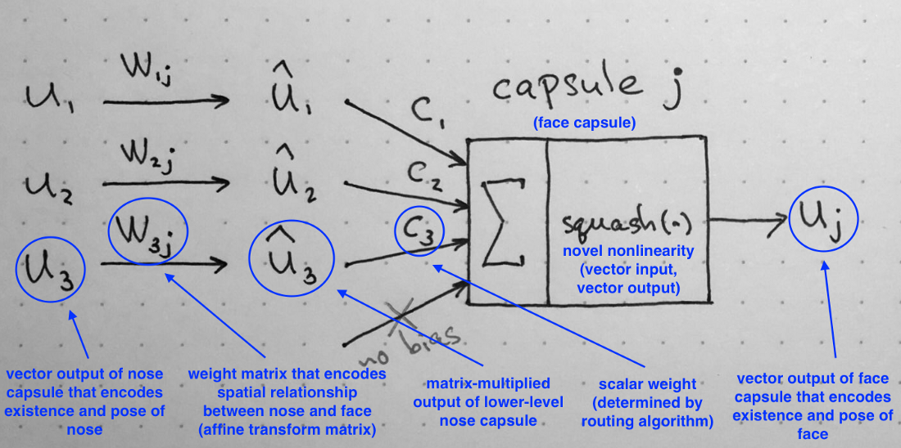
Backprop Dynamic Routing
To increase network accuracy through training feedback must be propagated from output layer all the way back to input layer
Is the basis for CNNs
Increases in network accuracy can be achieved through interactions between just two adjacent layers at a time
increased locality of information
Is used in conjunction with back propagation in capsule-based neural networks
https://brandonlmorris.com/2017/11/16/dynamic-routing-between-capsules/
https://medium.com/ai%C2%B3-theory-practice-business/understanding-hintons-capsule-networks-part-iii-dynamic-routing-between-capsules-349f6d30418

